Slide 1





Employee Data Analysis using Excel
STUDENT NAME
REGISTER NO
DEPARTMENT
COLLEGE
: S MANJUPRIYA
: 312204720/
67C3CB49225BCAD314273D721B0E87
: B.COM GENERAL
: NEW PRINCE SHRI BHAVANI ARTS
AND SCIENCE COLLEGE
1

Slide 2


PROJECT TITLE
Employee Performance Analysis
using Excel
2

Slide 3



AGENDA
1.Problem Statement
2.Project Overview
3.End Users
4.Our Solution and Proposition
5.Dataset Description
6.Modelling Approach
7.Results and Discussion
8.Conclusion
3/21/2024 Annual Review
3

Slide 4

PROBLEM STATEMENT
Prformance analysis are made to a employees.
Increment to check the performance track of the employees and it is useful for the
employees personal as well as organizational
growth.
So, the employees performance analysis helps
to require all the problems and have a
successful organisation.
4

Slide 5

PROJECT OVERVIEW
Analysing the performance of the employees by
considering the various factors like;
Gender,
Performance score and
Ratings.
Their involvement in work and various scores that analysis
the performance of employees in the organization.
5

Slide 6

WHO ARE THE END USERS?
Employees Employer Manager,
Gets benefits from the performance appraisal
6

Slide 7

OUR SOLUTION AND ITS VALUE PROPOSITION
Conditional Formatting – missing values
Filtering : remove missing data
Formulas : performance evaluation
Pivot : summary
Graph : data visualization
7

Slide 8

Dataset Description
EMPLOYEES DATABASE KIGGLE
There are 26 features but we consider 9 features
Employees ID
Name
Performance
Gender
Employees rating
Numerical data
Text
Level
Male Or Female
Numerical data

Slide 9

THE "WOW" IN OUR SOLUTION
Sample Queries:
1. Get all characters in a guild: `SELECT * FROM Characters JOIN Members ON CharacterID = CharacterID WHERE GuildID =
[GuildID]`
2. Get all raids a character has participated in: `SELECT * FROM
Raids JOIN RaidMembers ON RaidID = RaidID WHERE CharacterID = [CharacterID]`
This database design captures key WoW data and relationships,
enabling you to store and query character, guild, and raid
information.
3/21/2024 Annual Review
9

Slide 10


MODELLING
1.Data collection
2.Feature collection
3.Data cleaning
4.Performance level
5.Summary
6.Visualisation
10

Slide 11
Data collection
In data collection we download the data from
the edunet dashboard to work in the excel.
Feature collection
So many features are used in the data like filtering,
formatting, formulating. Pivot table, graph and used in data.
Data Cleaning
Identified the missing values and remove those missing
value from the data.

Slide 12
Performance level
We evaluate the performance of the employees
according to the data.
Summary
Pivot table we are categorized the columns what we
need and organization in the data.
Visualisation
In graph method we have shown the performance
data analysis and it is easy to identify the percentage.

Slide 13
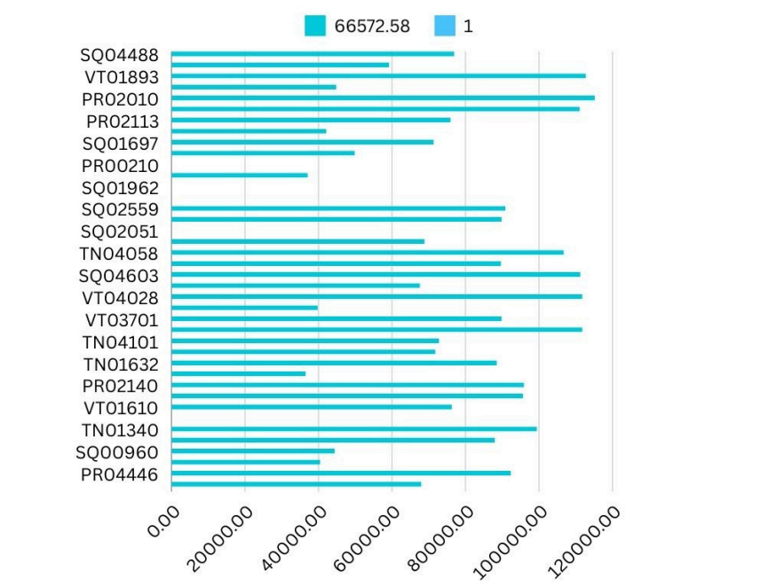
13
RESULTS

Slide 14
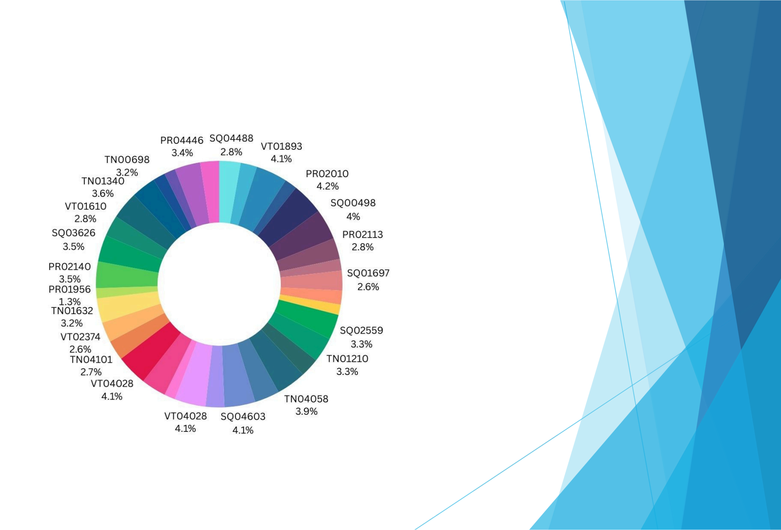
RESULT:

Slide 15
conclusion
While comparing the performance of
employees, the number of employees are
higher in number is in the average
performance where excellence employees are
less in percentage. So to overcome this we
should motivate the employees by giving there
different tasks based on their skills to improve their performance in their work.

